Slide 1

LEARNING PROJECT-1
B.TECH 2022-26 3RD SEM LEARNING PROJECT Submitted by Devashis Kumar , Rishikesh Kumar
22CSE209 , 22CSE204 Under the Guidance of Asst. Prof. Satya Narayan Sahu
BACHELOR IN TECHNOLOGY DEPARTMENT OF COMPUTER SCIENCE & ENGINEERING SCHOOL OF ENGINEERING AND TECHNOLOGY GANDHI INSTITUTE OF ENGINEERING & TECHNOLOGY UNIVERSITY, GUNUPUR- 765022, ODISHA September 2023

Slide 2
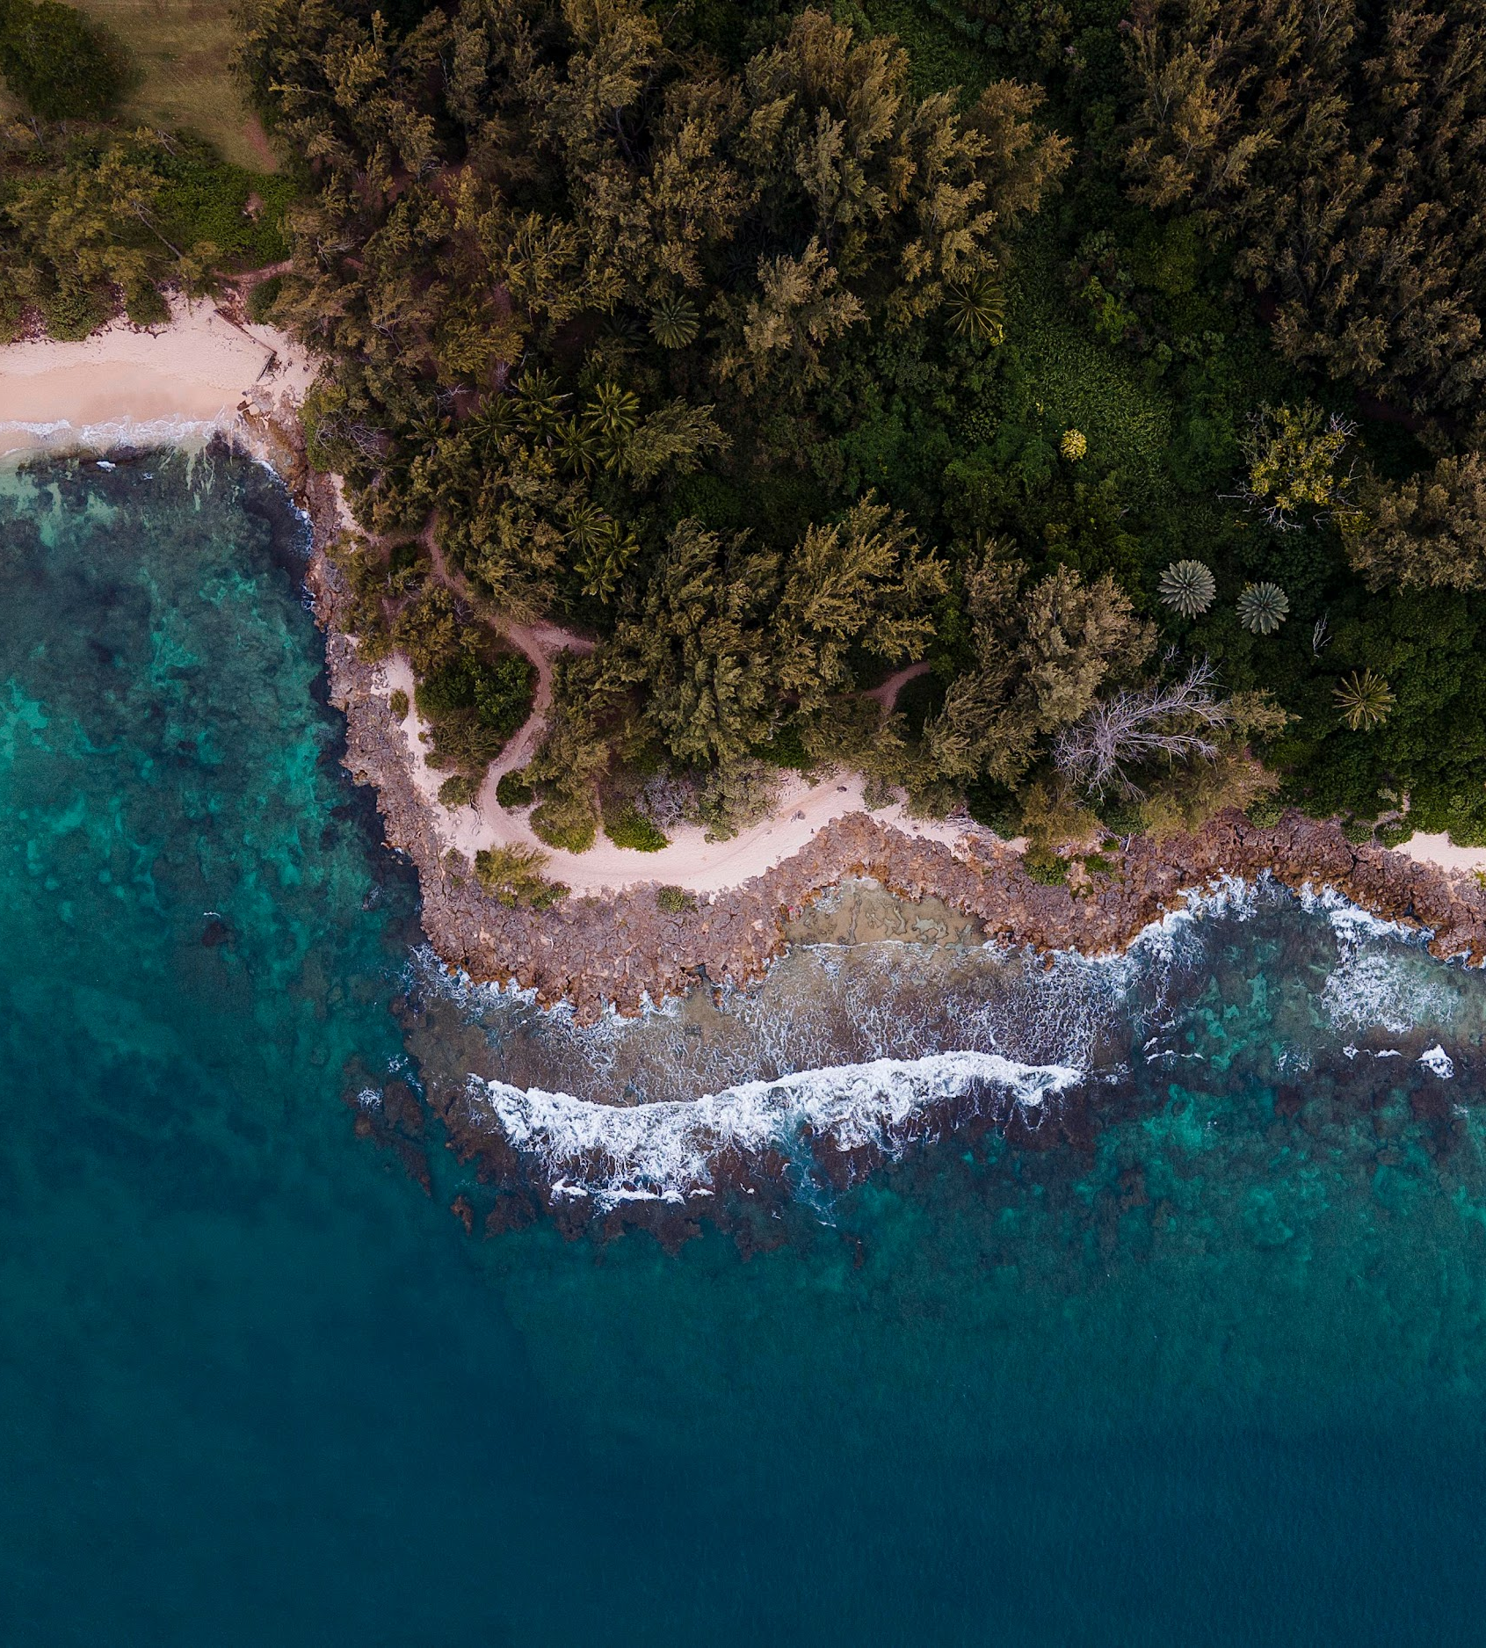
Wandering in Jharkhand
A Virtual Exploration of the Land's Treasures

Slide 3

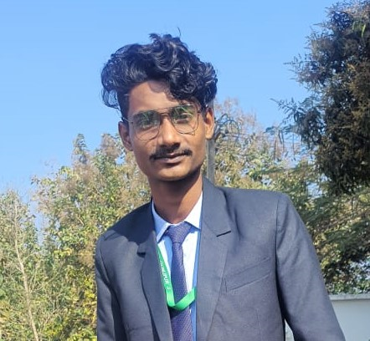
Our Team:-
DEVASHIS KUMAR
22CSE209
(Team Leader)
.
RISHIKESH KUMAR
22CSE209
(Co-Leader)

Slide 4
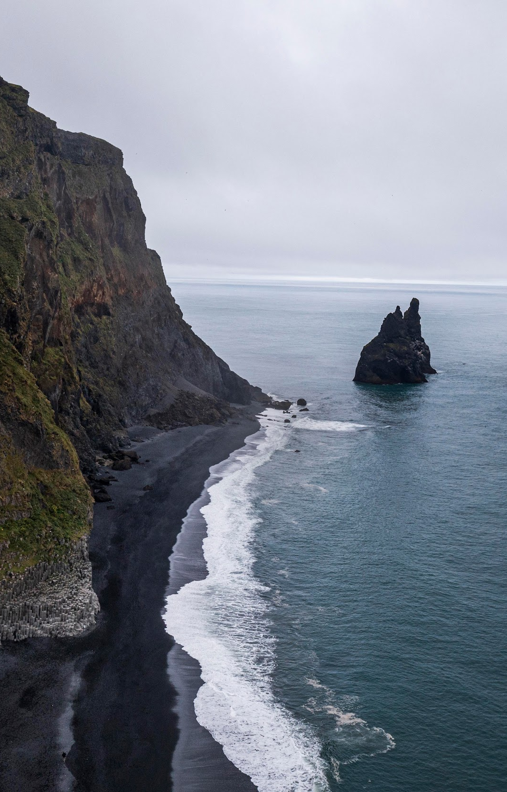
Table of Contents
Introduction
Objective of the Project
Hardware
Software
Analysis of the Project
Key Features
Flow Chart
Sneak Peak of Website
Conclusion

Slide 5
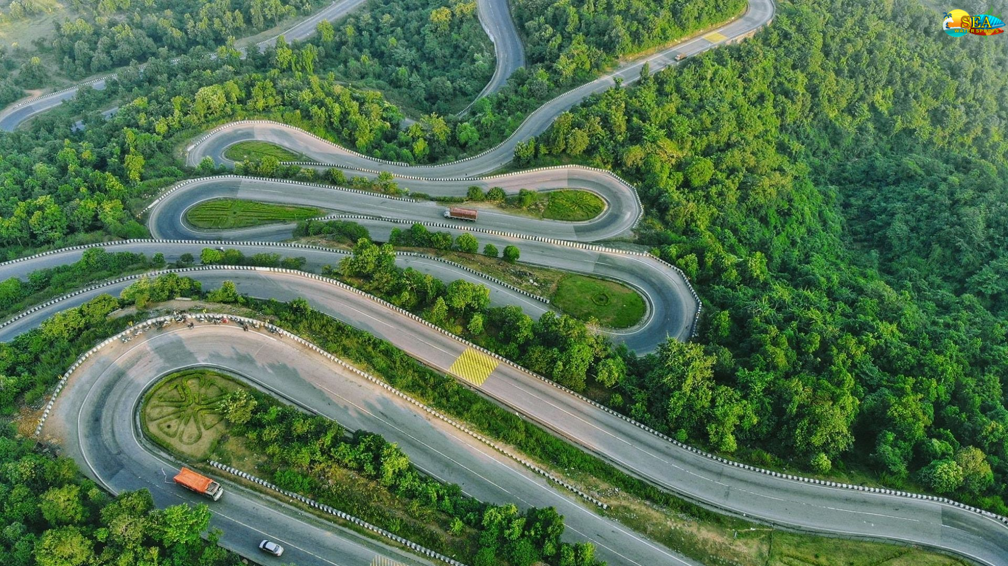
Introduction
Welcome to "Wandering in Jharkhand," a digital portal to the unexplored gems of India's captivating region. Through narratives and images, we bridge the gap between screens and the essence of Jharkhand, evoking curiosity and igniting wanderlust. Join us in rediscovering the joy of exploration and connecting with a land pulsating with stories waiting to be discovered. With every click, you're not just wandering through a website – you're wandering through the essence of a land worth knowing.

Slide 6
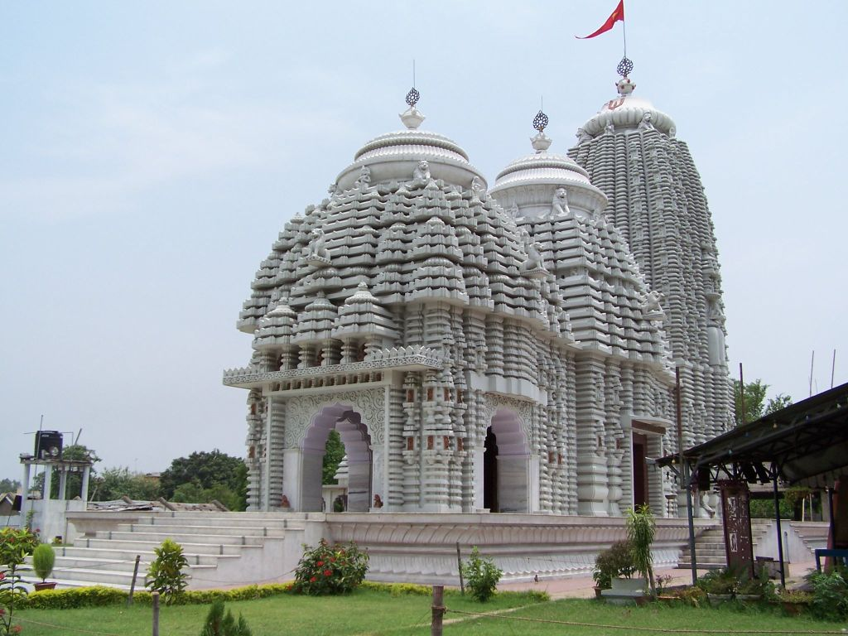
Objective of the Project
The primary objective of "Wandering in Jharkhand" is to provide a comprehensive and engaging platform where users can virtually explore the diverse tourist destinations in Jharkhand. The project aims to captivate users through detailed descriptions, captivating imagery, and historical narratives that enrich their understanding of the state's hidden treasures. By offering a digital gateway to Jharkhand's beauty and history, the project intends to ignite wanderlust, inspire physical visits, and foster appreciation for the region's cultural heritage.

Slide 7
REQUIREMENT:-
Hardware:-
The project primarily relies on standard hardware components such as computers, tablets, and smartphones for user interaction.
Software:-
The software components include a mix of technologies, including HTML, CSS and JavaScript for managing user interactions. To ensure a seamless user experience, responsive design principles will be employed to optimize the website's performance across different devices.

Slide 8
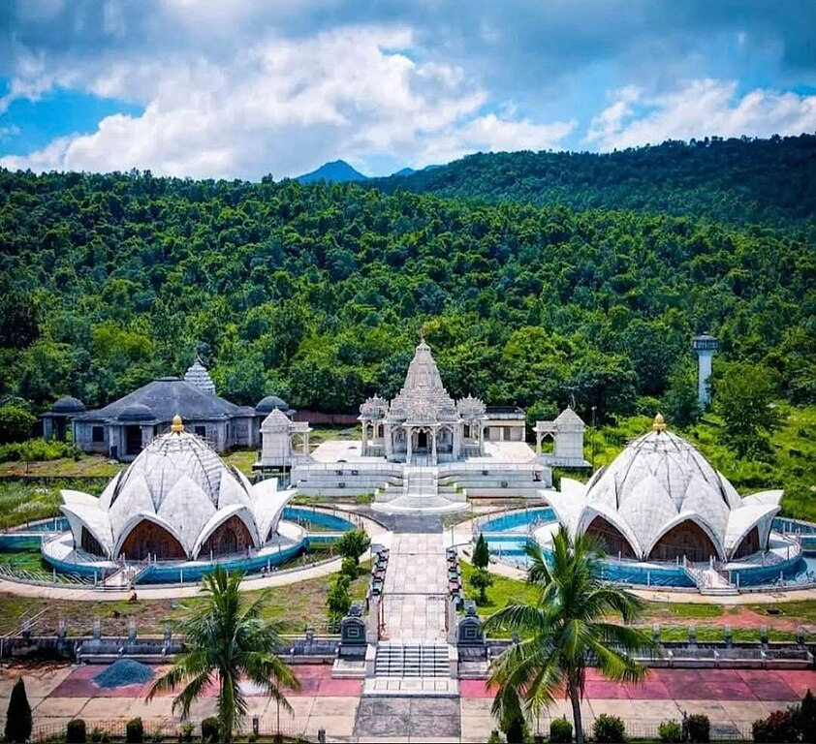
Analysis of the Project:-
User Experience:-
The website will be designed with user-centric principles, focusing on easy navigation, readability, and visual appeal. An interactive map and filters will aid users in discovering specific places of interest.

Slide 9
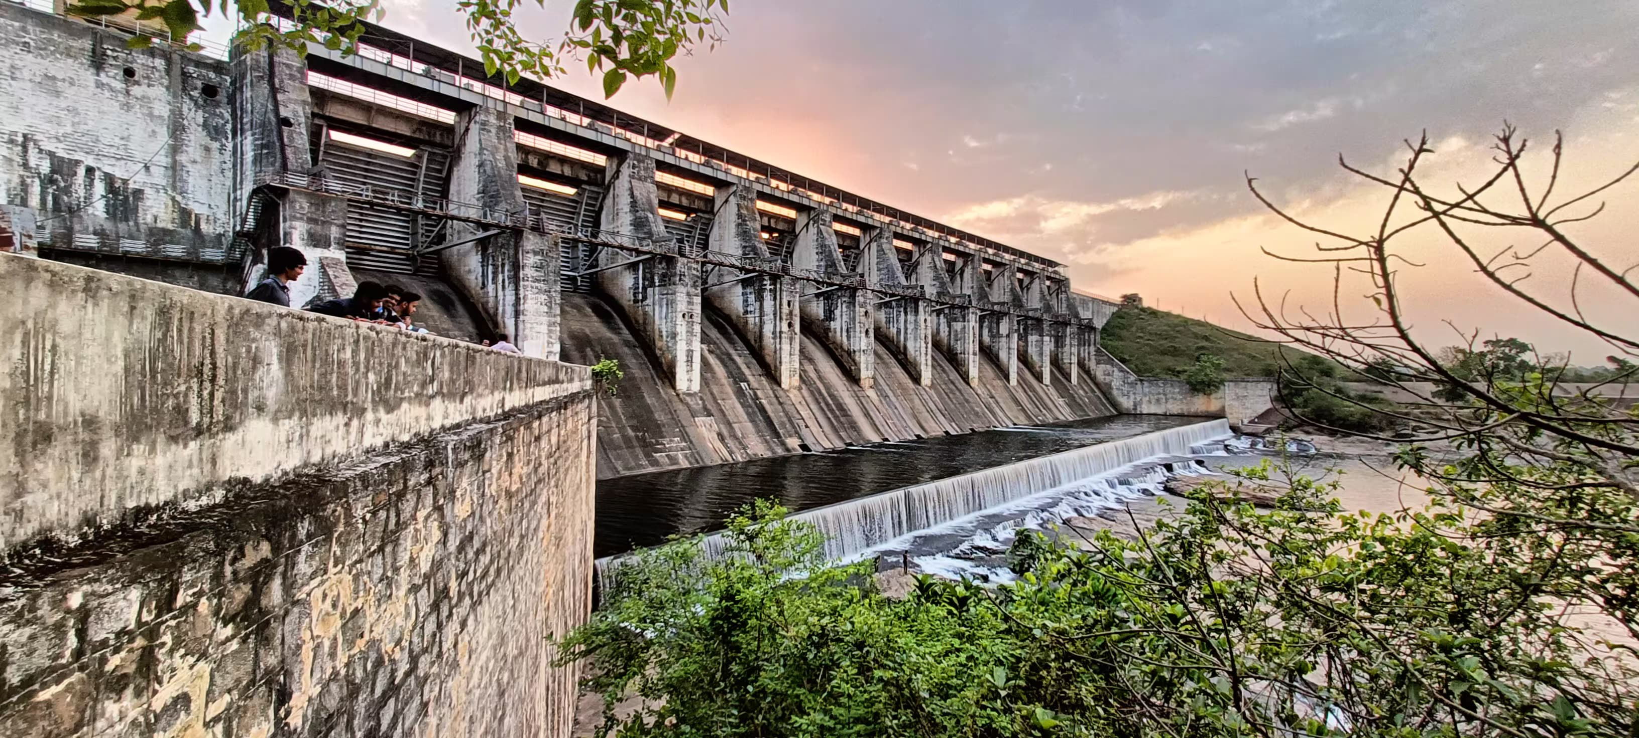
Multimedia Integration:-
High-quality images and multimedia elements will be strategically placed to enhance the visual storytelling and immerse users in the exploration.

Slide 10
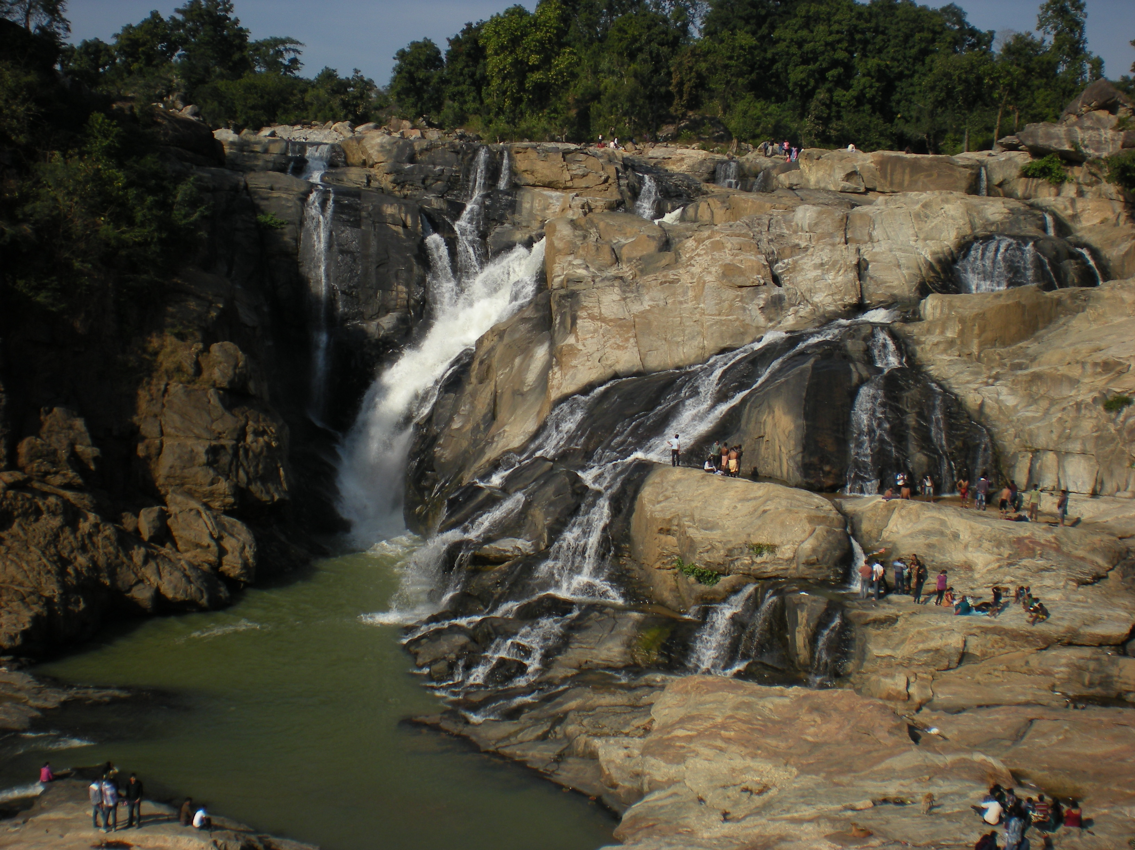
Historical Narratives:-
Detailed historical narratives will provide context and insight into the evolution of each destination, connecting visitors with the past.

Slide 11
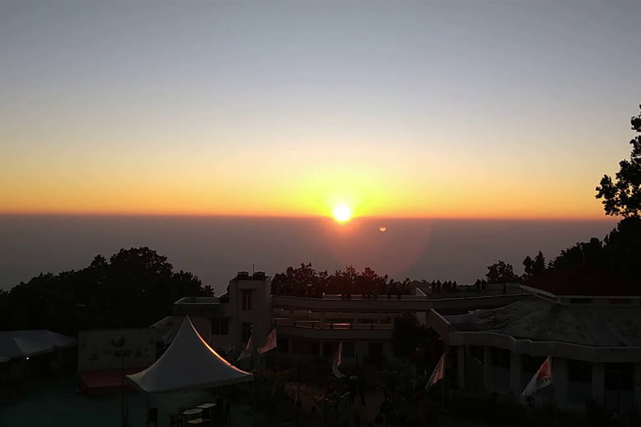
Practical Information:-
Practical details such as travel recommendations, accommodations, local cuisines, and best times to visit will empower users with actionable information.

Slide 12
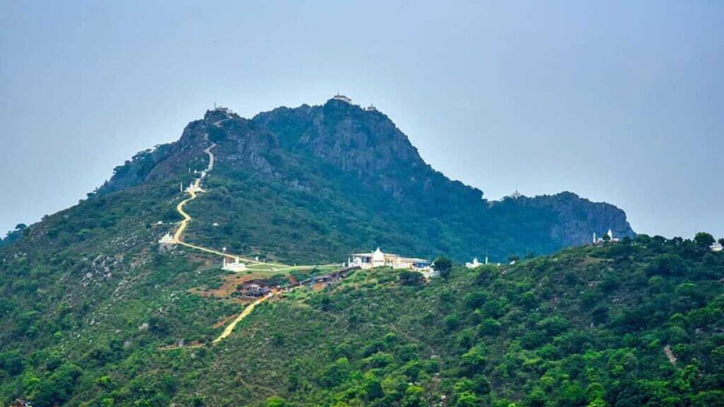
Key Features:-
Category wise tourist Insights
User Friendly
Interactive visual
Detailed Information
Easy and Attractive Navigation

Slide 13
Flow Chart :-
Start
Home Page
Desire
All Photos
Gallery
About
Our Developer
Destination
Jagannath Temple
Lotus Jain Temple
Baba Dham
Trikut Hill
Hunndru Fall
Ormanjhi Zoo
Lotus Temple
Maithon Dam

Slide 14
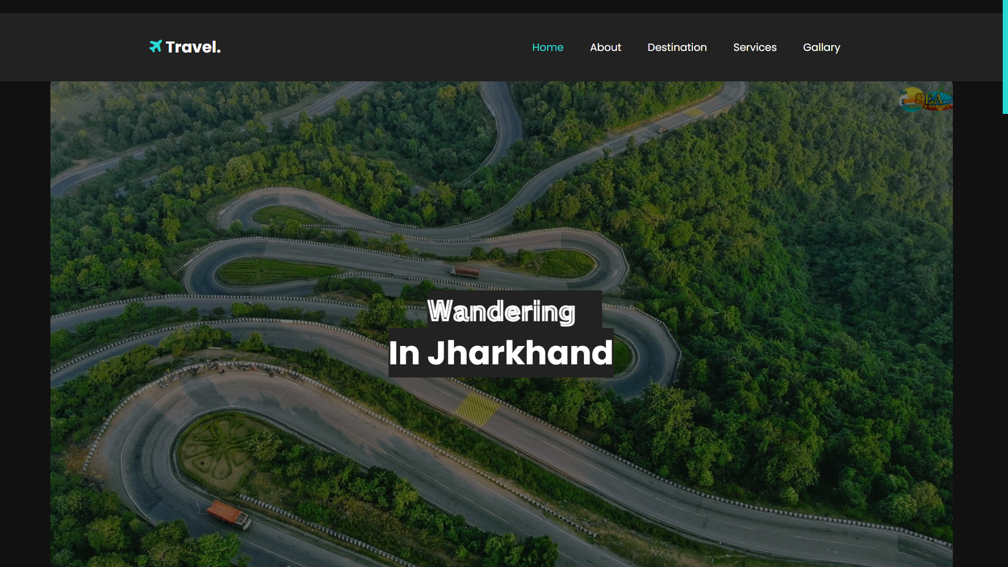

Slide 15
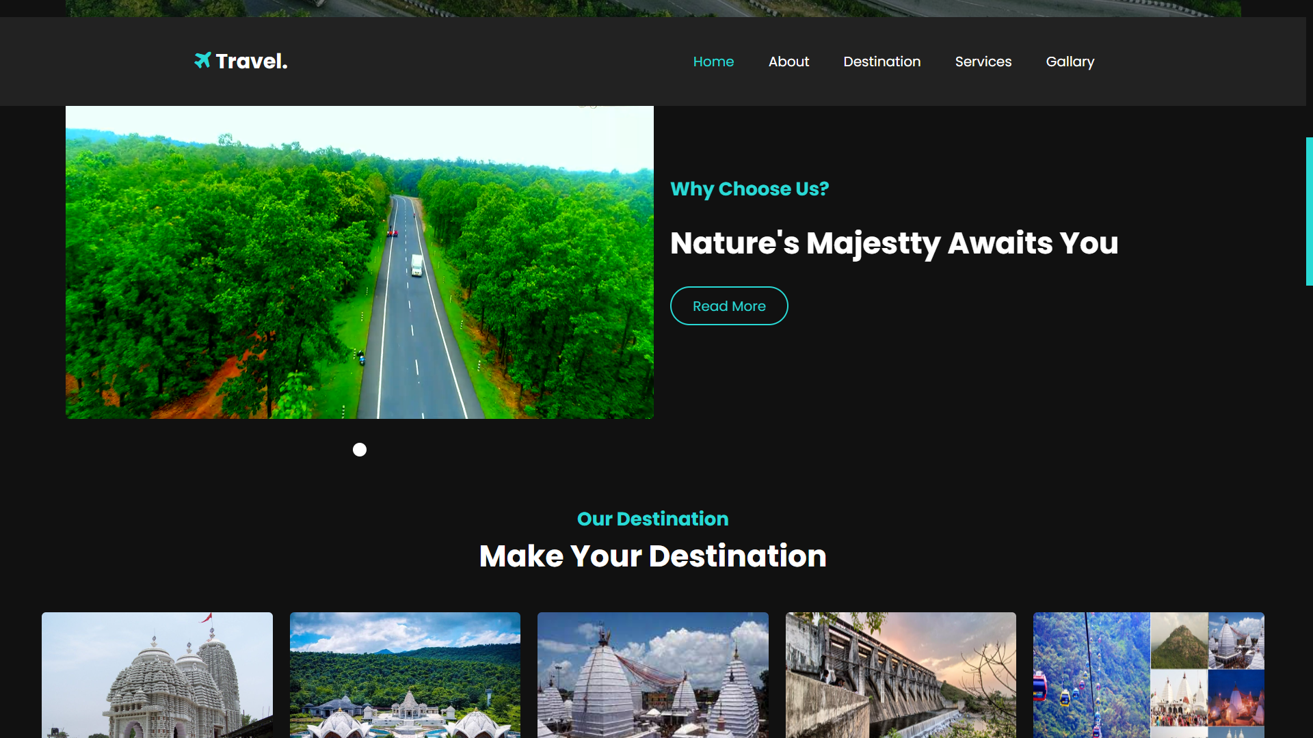

Slide 16
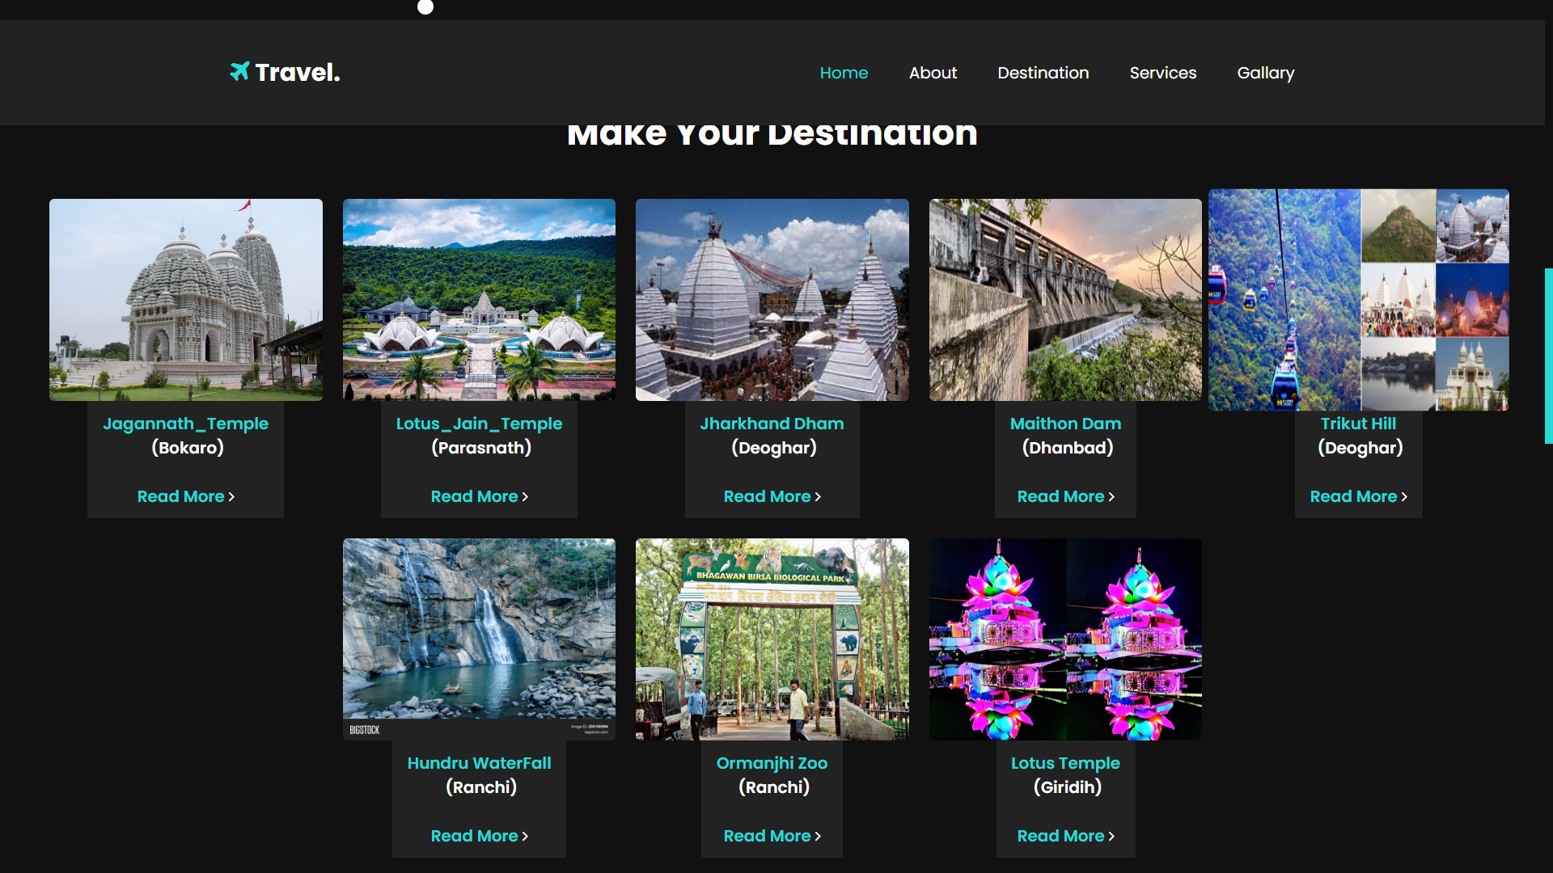

Slide 17
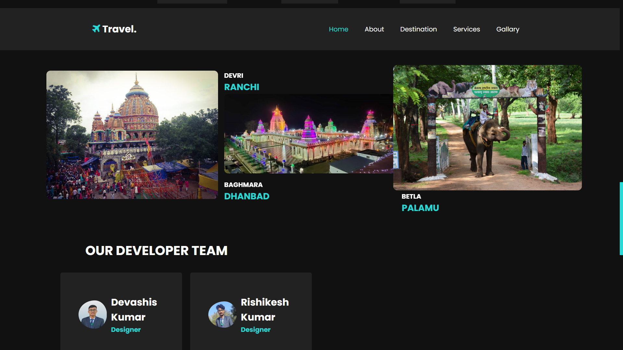

Slide 18

Conclusion: -
"Wandering in Jharkhand" redefines the concept of exploration by offering a digital haven to traverse the landscapes of a region's history, culture, and natural beauty. Through immersive narratives and captivating visuals, users are transported to the heart of Jharkhand's enchanting destinations. The project's innovative blend of technology and storytelling underscores the potential of digital platforms to nurture wanderlust and spark a newfound appreciation for lesser-explored regions.

Slide 19

Thank You

